Slide 1
Cross-Platform Mobile Application Development
B.Sc. Web Technologies & Programming
Department of Computer Science & Applied Physics

Slide 2
DOM
“The Document Object Model is a platform- and language-neutral interface that will allow programs and scripts to dynamically access and update the content, structure and style of documents”

Slide 3
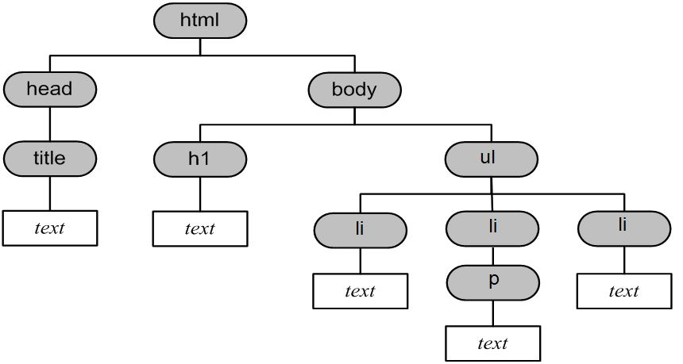
HTML & DOM
<!DOCTYPE html>
<html>
<head>
<title>The DOM</title>
</head>
<body>
<h1>This is Heading One</h1>
<ul>
<li>First Item</li>
<li>Second Item
<p>Paragraph describing Second Item</p>
</li>
<li>Thrid Item</li>
</ul>
</body>
</html>

Slide 4
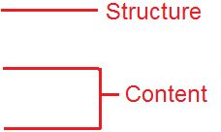
DOM
A HTML page can be viewed as a network of interconnected nodes.
3 basic node types make up a HTML page
Element Nodes
Text Nodes
Attribute Nodes

Slide 5
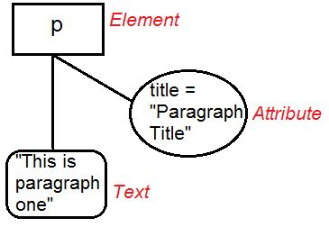
DOM
<p title=“Paragraph Title”>This is paragraph one</p>

Slide 6
JavaScript & The DOM
With JavaScript you can add, remove or modify HTML (and CSS) elements and attributes
JavaScript can also react to (or add) events
The DOM can be thought of as an API for accessing the HTML

Slide 7
Common DOM Methods & Properties
getElementById()
<h1 id="myh1">This is Heading One</h1>
var x = document.getElementById(“myh1”);
firstChild
var x = document.getElementById(“myh1”).firstChild;
nodeValue
var x = document.getElementById(“myh1”).firstChild.nodeValue;

Slide 8
Common DOM Methods & Properties
<ul>
<li>First Item</li>
<li>Second Item </li>
<li>Thrid Item</li>
</ul>
getElementsByTagName()
var x = document.getElementsByTagName(“ul”);
How would you print out “First Item”, “Second Item”, “Third Item”?
var x = document.getElementsByTagName("li");
for (var i=0; i<=x.length-1; i++) {
console.log(x[i].firstChild.nodeValue);
}

Slide 9
Common DOM Methods & Properties
<h1 id="myh1">This is Heading One</h1>
<p class="main" id="one">Paragraph one</p>
<p id="two">Paragraph Two</p>
<h2 class="main">Heading Two</h2>
<div class="main">More Text</div>
getElementsByClassName(“main”);
How would you print out the text associated with the class “main”?
var x = document.getElementsByClassName("main");
for (var i=0; i<=x.length-1; i++) {
console.log(x[i].firstChild.nodeValue);
}

Slide 10
Common DOM Methods & Properties
<p id="myh1"></p>
var x = document.getElementById(“myh1”);
console.log(x.firstChild.nodeValue);
Not all nodes have Child Nodes:
if (x.hasChildNodes()) {
console.log(x.firstChild.nodeValue);
}

Slide 11
Common DOM Methods & Properties
innerHTML property sets or gets the HTML syntax describing the element's descendants.
<p id="p1">Hello World!</p>
document.getElementById("p1").innerHTML = "New text!";

Slide 12
More DOM Methods & Properties
https://developer.mozilla.org/en-US/docs/Web/API/Document
https://developer.mozilla.org/en-US/docs/Web/API/Node

Slide 13
Events
An Event is “a thing that happens, especially one of importance”.
An Event in a webpage can be:
The page has been loaded
The user clicks a button
An image has been loaded
The user enters text
...

Slide 14
Events
onclick Usually specifies a function to be called when an Element is clicked.
<p id=“para1”>This text will change</p>
<button onclick="myFunction()">Click me</button>
function myFunction() {
document.getElementById(“para1").innerHTML = “New Text";
};

Slide 15
Events
https://developer.mozilla.org/en-US/docs/Web/API/GlobalEventHandlers

Slide 16
onload
Cannot access any DOM Elements until the document has been loaded
window.onload
When the entire page is loaded, including images, scripts, CSS etc
document.onload
When the DOM is ready. This can be before the page is fully loaded e.g. not all images/scripts may be available.

Slide 17
onload
window.onload=FunctionReference;
var myFunction = function() {
:
};
window.onload=myFunction;
Why not window.onload=myFunction();
Because you are just referencing the function, not calling it.

